Slide 1
Project Title: Crafting & Compelling Website Analysis, Audit and Recommendations
Name: Subash M
Batch: MBT12

Slide 2
Task 1: Company Selection
I selected the company “3M INDIA” for this Web Presence Project.
About the company:
3M Car Care offers a wide range of automotive products designed to clean, protect, and repair vehicles. These include abrasives, adhesives, waxes, polishes, and cleaning products that help car enthusiasts, professionals, and DIYers maintain their vehicles.
The brand is known for its innovative solutions, such as headlight restoration kits, scratch removers, and high-performance tapes that help improve both the appearance and durability of cars.

Slide 3
Task 2: Product and Service Descriptions
Product:
3M Bondo Car Wash Shampoo
Removes tough dirt and road ​grime
3M Car Cleaning Kit
One kit for your car's ​appearance needs
3M Microfibre Detailing Cloth
Remove wax or polish residue and ​fingerprints
3M Premium Liquid Wax, 200 mL
Clear coat safe wax
Service:
Diesel Fuel System Cleaner
Full Water wash and Vacuum
Wash and Wax
Tires & Wheel Balancing​​
Window Film
Car Wraps
Body Repair & Painting

Slide 4
Task 3 - Website Platform Identification:
The website is developed on HTML & JAVASCRIPT identified using BuiltWith.

Slide 5
Task 4 - Responsive Design Testing
Tools Used: Google Test (lighthouse) and pagespeed insights
Report:
The overall test shows a desktop score has 78 but for mobile it is very poor scores it got only 19 which shows it is not that much mobile friendly website.

Slide 6
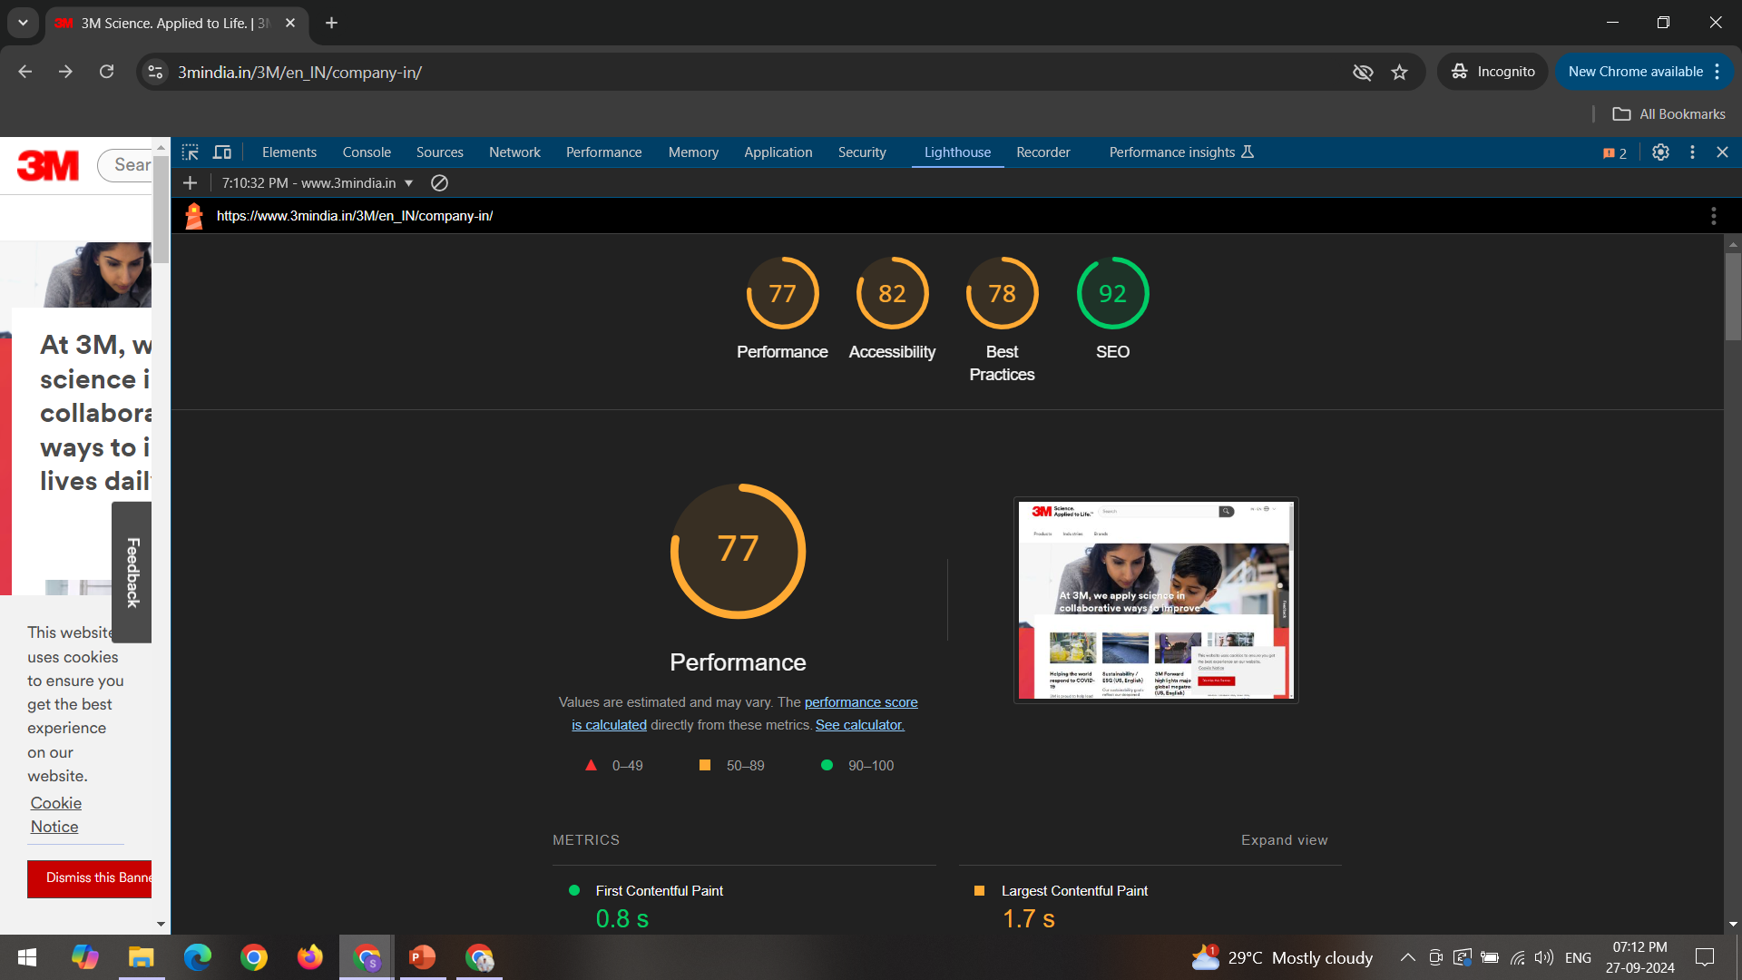
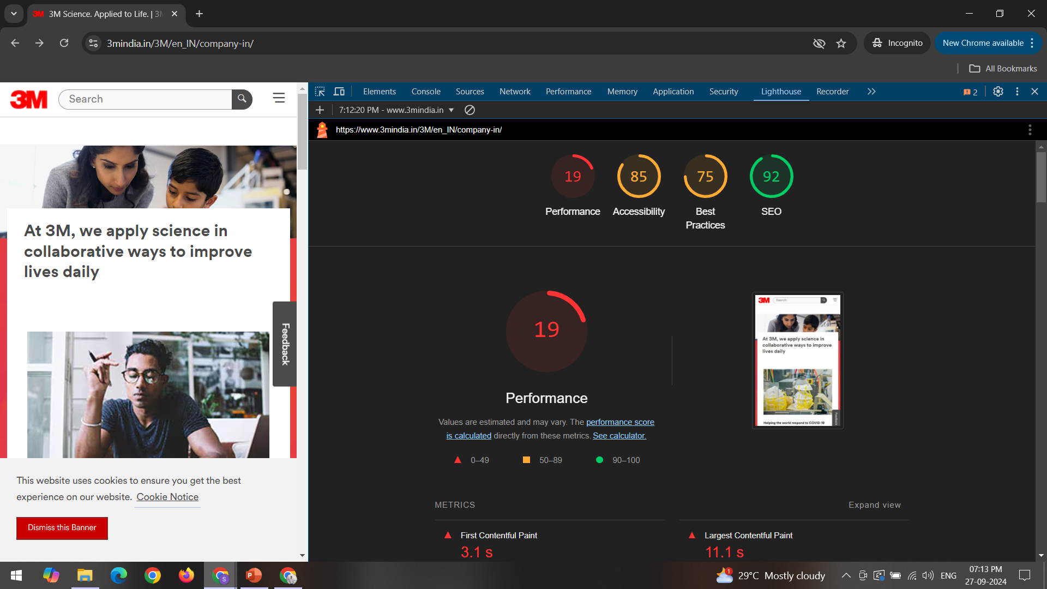
Test running results:
Desktop testing results
Mobile testing results

Slide 7
Task 5 - Website Mistakes Identification
Suggestions to 3M Website:
Improve website for mobile friendly because of mostly people search thing using mobile only
improve the about us page for clear information
Improve image quality
Links do not have a discernible name
Improve Background and foreground colors because do not have a sufficient contrast ratio.

Slide 8
Task 6 - Website Best Practices List
Put the user's experience first with simple navigation.
Put mobile-first design concepts into practice.
Keep your branding constant across the website.
Make multimedia and photos load more quickly.

Slide 9
Task 7 - Landing Page Design
Objective: showing that best car care company
Design Features:
A clear view of 3M company.
Basic web building only for car cares.
Showcasing car care products with nassery details.
Showing what they can do in car care.

Slide 10
Task 7 - Landing Page Design
Landing page: for mobile view: https://drive.google.com/drive/folders/1UILcVVyeC_7MEkqnkMp0JX2hse0BbY8n?usp=sharing
For desktop view: https://3mcar2024.my.canva.site/
Website: https://dev-3mcarproject.pantheonsite.io/
(note: I was not using original WordPress because of that it shows lot of error when I share the link, but I learned how to build a website using WordPress)

Slide 11
Conclusion:
The goal of this project was to create an engaging and easy-to-use online presence for 3M car care. It has effectively illustrated the fundamentals of digital marketing and website design.
Through comprehending the foundations of digital marketing, recognizing important design concepts, and putting best practices into reality.
To increase brand recognition and produce leads, I have created a landing page that highlights 3M cars in an efficient manner.
The practical insights and design suggestions offered will support 3M auto care's ongoing enhancement and optimization of its online presence.

Slide 12
Thank you

